Slide 1


City of Tracy
Wastewater Rate Study
Public Hearing Presentation
June 20, 2023

Slide 2
Terms You May Hear Tonight
Rate Study – The process of determining proposed utility rates
Financial Plan – Part of a rate study that projects revenue and expenses to see if revenue is enough to cover expenses
hcf – The unit used to charge for water. One hcf = 100 cubic feet = 748 gallons. This is a commonly used billing unit in California.
Capital – refers to large infrastructure assets/costs such as pipelines, treatment plants, pumps, etc.
Rate – The amount charged per unit of wastewater
Cost of Service – The utility’s cost to provide water service to each customer class based on the demands they place on the utility
Customer Class – Single Family Residential, Multifamily, Commercial and Irrigation
Volumetric rate – The amount charged per unit of water used
Fixed charge – The amount charged by meter size, it does not vary by water use

Slide 3







What is a Rate Study?
A financial planning process to set rates that considers:
Promotes Utility Financial
Viability
Cover Ops and Maintenance
Cover Infrastructure
Investment
Fairness & Equity
Community
Values
Legally Defensible
Notes:
Ensure rates customers pay are: (Click)
Fair and equitable (Click)
Align with community values and priorities (Click)
Sufficient to ensure the utilities’ continued financial viability
Your water and wastewater utilities are owned by you, the customer. They can not charge more than the cost of providing the service; this is not a profit center for the City’s general fund, and there are no shareholders looking for dividends. (Click)
Sufficient to enable efficient operations and critical routine maintenance (Click)
Sufficient to enable critical infrastructure investment to aid appropriate levels of service and comply with ever more stringent regulatory requirements (Click)
Aligned with industry best practices and compliance with state law. (Click)

Slide 4
Why would the City do a wastewater rate study?
Rates must keep up with costs to operate the City’s wastewater system
The City’s wastewater utility (Enterprise Fund) is a self-funding, enterprise - is not like other government services (Police, Fire, Parks) that are funded by tax dollars from the General Fund
The wastewater enterprise is funded by customer rate revenue
  It’s a non-profit business
Rate revenue pays for:
  O&M expenses (labor, supplies, chemicals, electricity)
  Capital: large projects to rehabilitate pipes and the treatment plant
  Debt service to pay back loans
  Reserve funding
By law (Proposition 218), rates must be based on the cost to operate and maintain the wastewater system

Slide 5
Why Do Rates Need to be Adjusted?
City has not raised wastewater rates since 2013!
City must meet bond covenants - debt coverage requirement (1.20)
Inflation since then: about 32%
Lots of capital projects planned that need to be funded
New staff
Wastewater desalination project
City has some of the lowest wastewater charges around

Slide 6
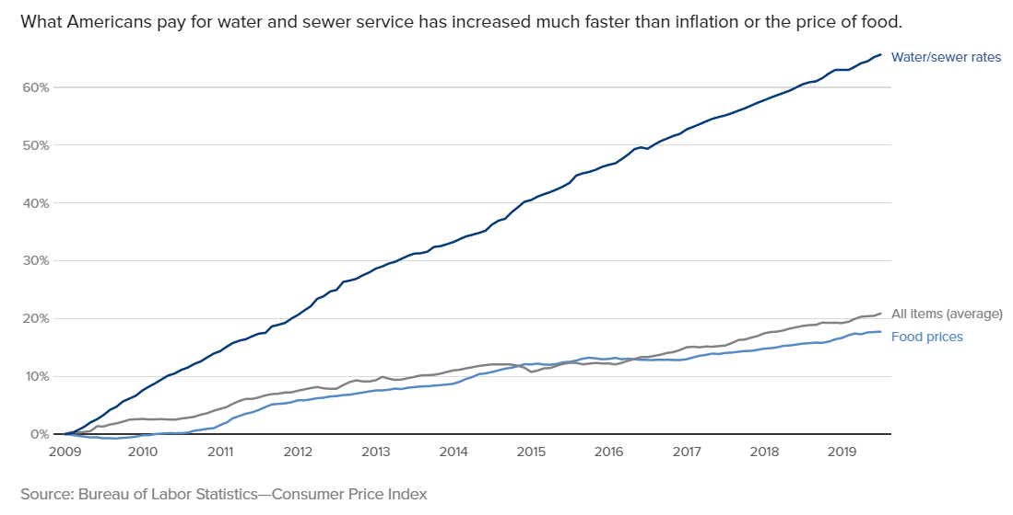
Utility Rates vs Other Goods
CBS News article: “Water costs are rising across the US – here is why”, August 27, 2019

Slide 7
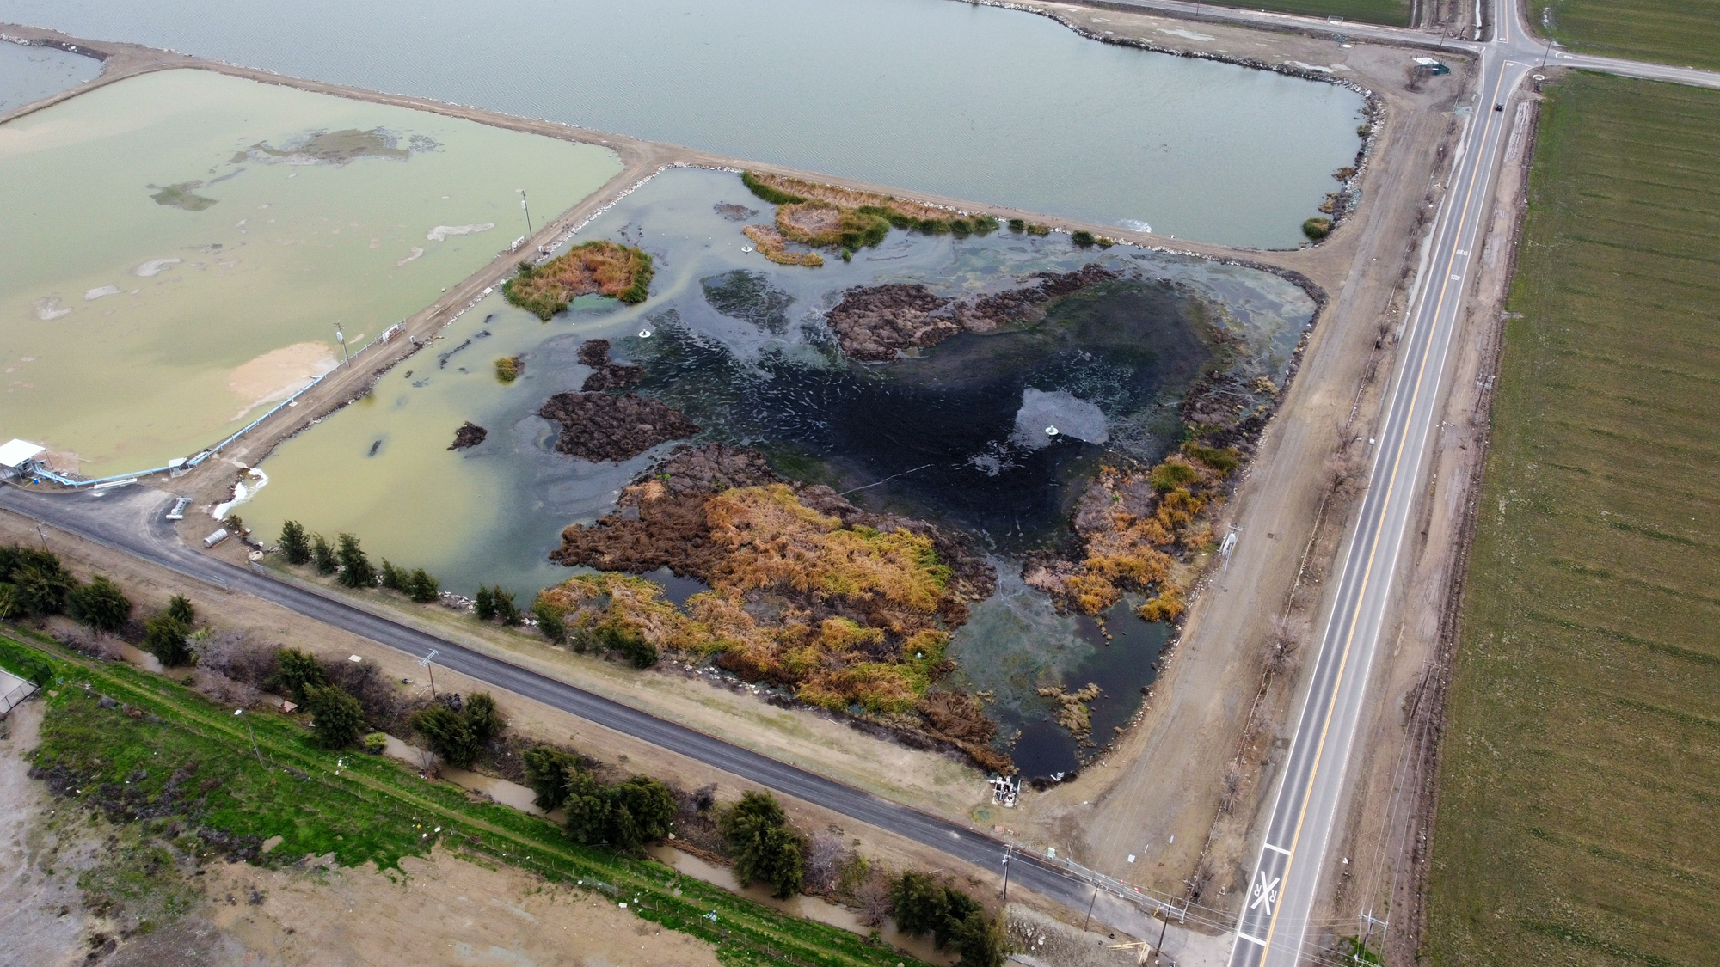
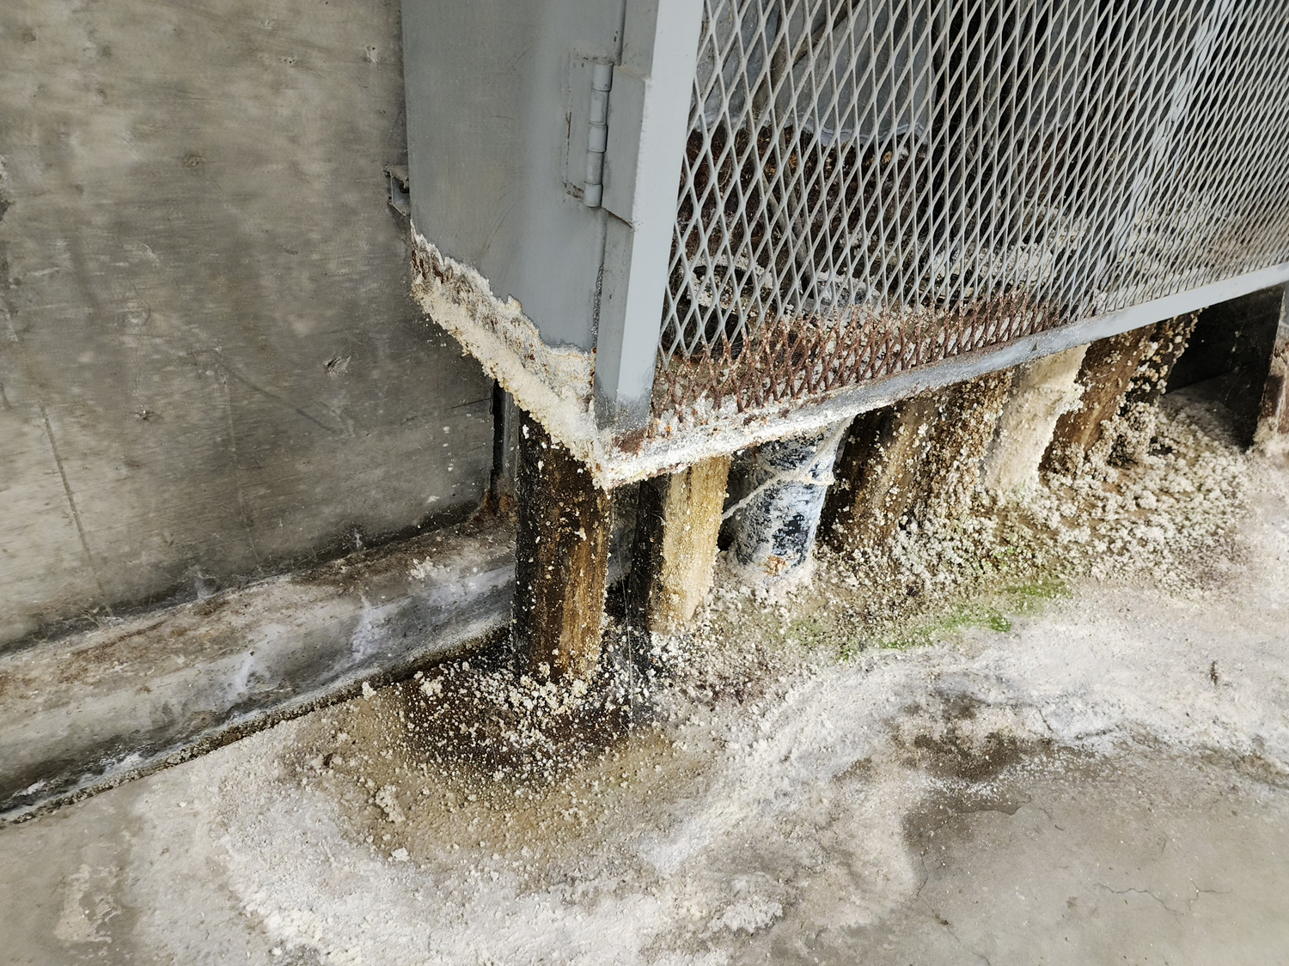
Critical Capital Needs – not currently funded
CRITICAL NEEDS – not currently funded
Emergency Storage Basin – vegetation
  Capacity has been reduced – needs cleaning
Pipe Gallery - erosion
Need to repair/replace
Pond 1 – full and compacted
  Need to allow it to dry out and then remove.
  PLC and Control Systems – out of date/no longer supported by manufacturer.
    Need to replace
    Disinfection unit – outdated, made to fit for the Recycled Water Project.
      Needs to be upgraded
    New Contact Basin – modifications needed.
      May require Ultraviolet instead of chlorine
      Old Concrete Tanks and Structures – need demolition
      CMMS – improved efficiencies

Slide 8
Financial Plan

Slide 9
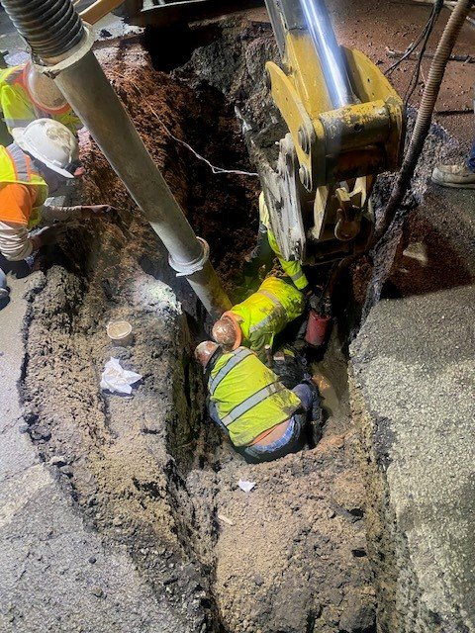
Financial Plan
Projects revenue and expenses to assess if revenue is sufficient to fund operations (expenses)
If not, we increase revenue to fund anticipated wastewater collection and treatment costs:
  O&M – chemicals, labor, parts, supplies
  Capital – large projects
  Reserves – O&M and capital reserves

Slide 10
Reserves and Debt Coverage
Need to financially plan for:
Operating reserve = 30% (110 days) of yearly operating expenses
Capital reserve = no official policy but we have modeled 2% of your wastewater asset value which is a common reserve target
Debt coverage ratio = 1.20 for Certificates of Participation
Debt coverage is a major driver for needed rate increases

Slide 11
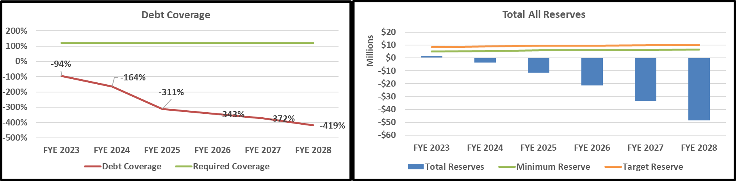
What if You Do Not Increase Rates?

Slide 12
Proposed Revenue Adjustments

Slide 13
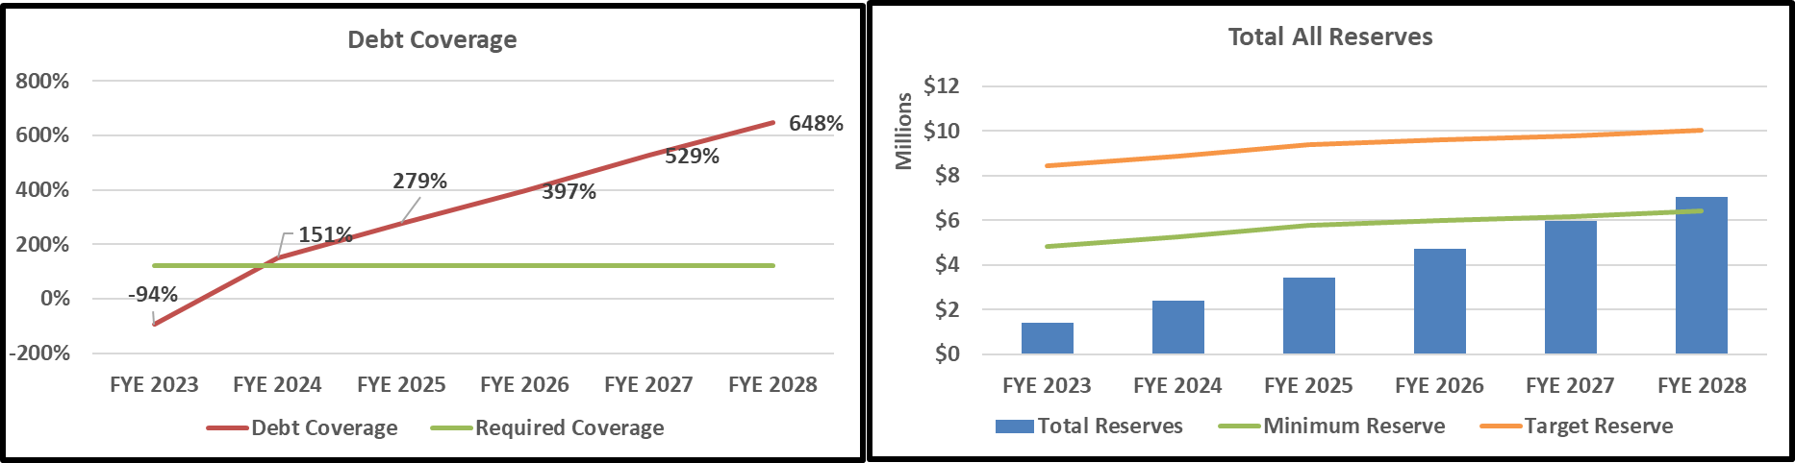
Financial Health with Revenue Adjustments

Slide 14
Cost of Service
& Rates

Slide 15
What Affects the Cost to Serve a Customer Class?
Wastewater flow
Strength of wastewater
  BOD – Biochemical Oxygen Demand
  TSS – Total Suspended Solids
Wastewater strengths are increasing due to low flow devices

Slide 16
Current Rates

Slide 17
Proposed Wastewater Rates
Proposed MFR charge is a per dwelling charge.
Average dwelling units per apartment complex is 7
Notes:
Can’t trace prior MFR charge

Slide 18
Customer Bill Impacts

Slide 19
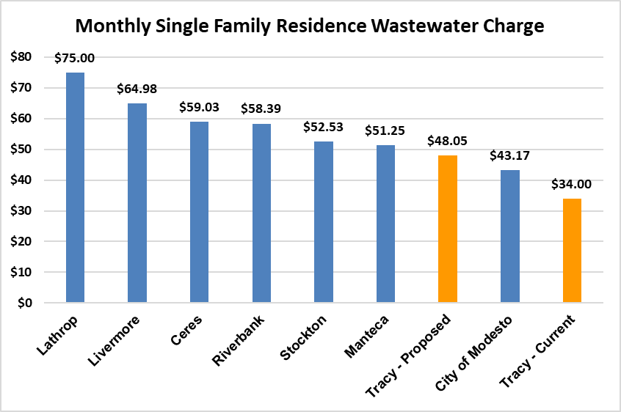
Wastewater Bill Survey

Slide 20
Monthly Bill Impacts

Slide 21
Likely Questions
Why are commercial bills going up?
  Commercial strengths (BOD, TSS) have been revised upward to industry best practices
  Commercial flows and strengths were trued to actual plant flows
Why are multi-family bills going down?
  Multi-family bills are now in proportion to use and assumed strength
  Cannot trace their prior derivation
  We assumed 100% of water returns to sewer
Flows are tied back to the total flow at the plant
Notes:
BOD for Commercial 1, 2 and 3 used to be 150, 300 and 600, now its 250, 500 and 1,000.

Slide 22
Low Income Rate Assistance (LIRA)
The City offers a Low-Income Rate Assistance (LIRA) program that provides a discounted rate for qualified customers.
The total amount of the discount is $26.05, with $2.55 of that being directly applicable to the Wastewater rate. The LIRA program is funded through the City’s General Fund.
Over the last year, the City has partnered with PG&E and is now able to auto enroll customers into the LIRA program. This partnership has resulted in a 400% increase in the number of households receiving the discount, from 1,275 to 5,100.

Slide 23
Summary
City has not raised wastewater rates in 10 years
Debt covenants are stressed
City Single Family Residential wastewater bills will still be lower than most surrounding agencies

Slide 24
End of
Presentation

